Slide 1
Rabin Karp Substring Search Algorithm
By: Shobhit

Slide 2
Overview:
String: abcd
Pattern: cd
We have to calculate the Hash of pattern H(cd) and in the string we need to calculate the hash of every 2 length substring in the string abcd
if( H(pattern) == H(substring) ) then we have to check weather the pattern is equal to substring or not

Slide 3
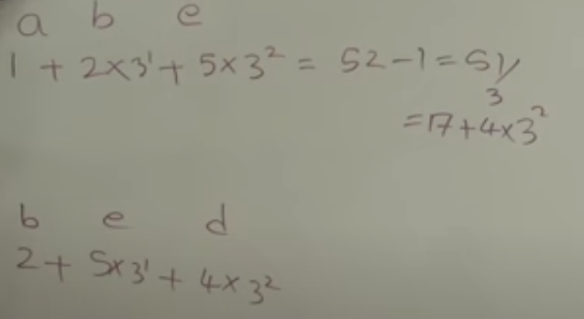
Efficient Hash Finding Algorithm of String:
1. Var1 = oldhash - val(old char)
2. Var1 = var1/prime
3. New_hash = var1 + prime^(m-1) * val(new char)
m: length of the pattern

Slide 4
Algorithm:
function RabinKarp(string s[1..n], string pattern[1..m])
2 hpattern := hash(pattern[1..m]);
3 for i from 1 to n-m+1
4 hs := hash(s[i..i+m-1])
5 if hs = hpattern
6 if s[i..i+m-1] = pattern[1..m]
7 return i
8 return not found
TC: O(m.n)
m: length of pattern
n: length of string
Source:wikipedia

Slide 5
Applications:
Finding pagla grim
If we have multiple pattern to match

Slide 6
Thank you

